Slide 1
Astounding Stories Database
Kieran Lyons

Slide 2
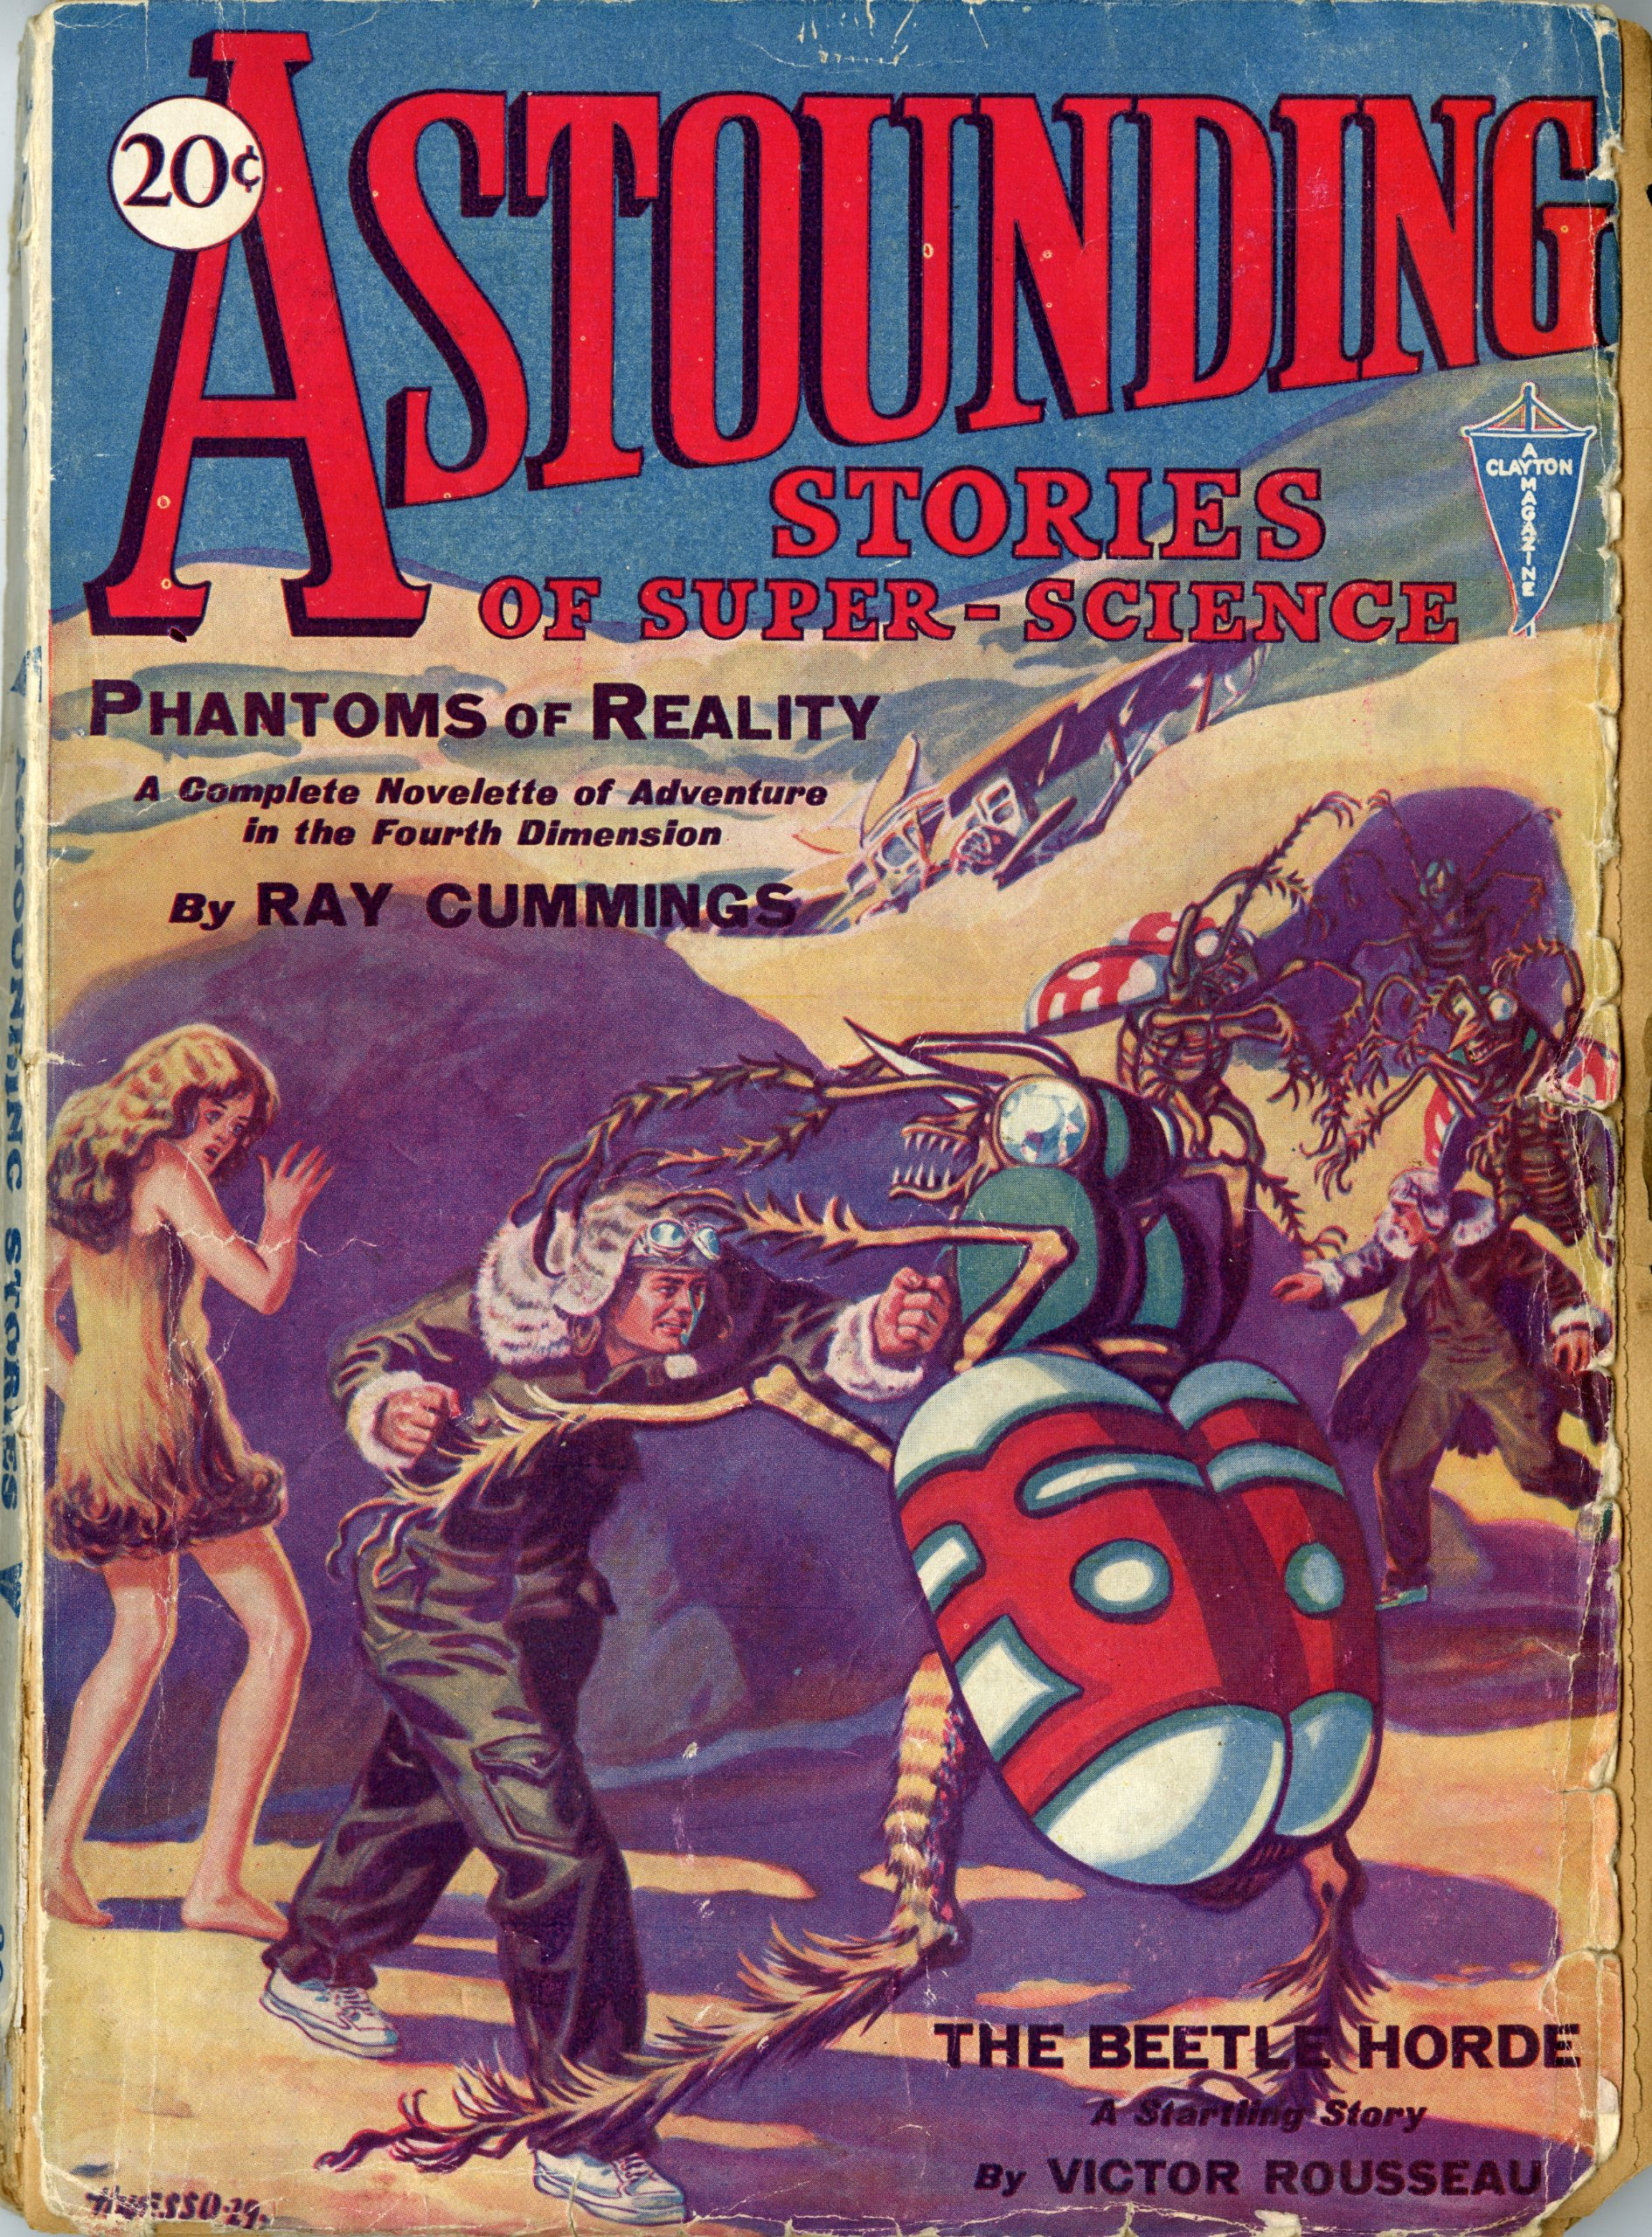
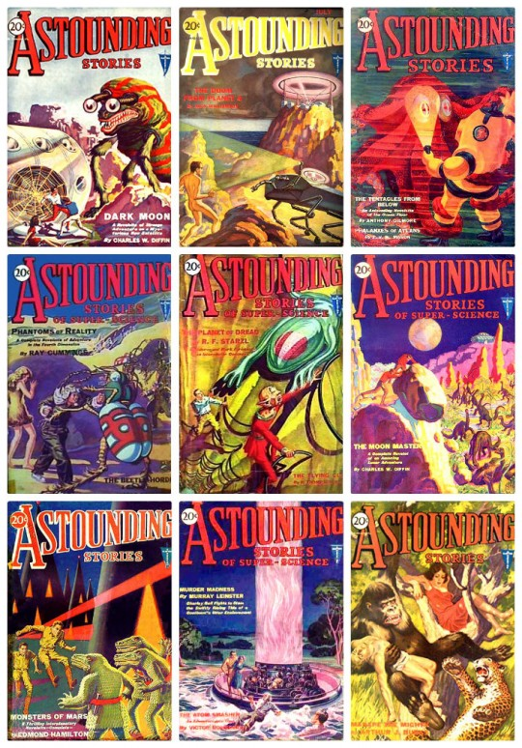

Slide 3
Astounding Stories of Super Science
Now called Analog Science Fiction and Fact
Longest-running science fiction magazine
Founded in 1929, “the first genre s-f pulp magazine“ (Bleiler 568)
First editor looked for “action fiction against a background of fantastic science that wasn't too far overboard” (Bleiler 566)
Notes:
No professional s-f writers existed at the time, so Harry Bates paid pulp writers very well

Slide 4
Starting Point: Project Gutenberg
Project Gutenberg includes transcriptions of the first several years of Astounding Stories (1930-1933) before the magazine temporarily folded because of financial problems
The copyright on these issues has not been maintained
Similar magazines such as Amazing Stories are still under copyright

Slide 5
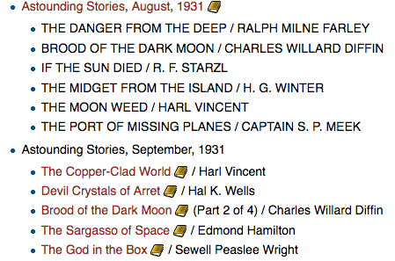
Raw Text Files
192 stories from a variety of transcribers
Some files are entire issues, others are individual stories
Some files also include:
  Advertisements
  Image captions
  Reader letters
  Teaser copy
  Table of contents
Non-descriptive filenames
Hard wrapping
Notes:
My focus was the stories themselves since letters, advertisements, etc. are not always available

Slide 6
Cleaning Text Files
Grep: a Unix command that allows pattern-based searching
Text Wrangler allows multi-file grep search and replace
Examples:
  ^\[Illustration: finds lines beginning with [Illustration:
  the \w* planet finds phrases with one word between “the” and “planet”
  (note: this includes phrases like “the new planetoid” and “wreathe the planets”)
Each paragraph on individual lines allows searching for dialogue, etc. Also allows easy import to Excel (later).
Manually removing all reference to Project Gutenberg allows files to be modified, shared, and analyzed without attribution.
Standardized filenames allows easy organization, desktop searching, etc.

Slide 7
The Database: What is it?
Excel file
Organized primarily around stories, but can be adapted
Genre-specific metadata for each story include:
  Traits of story expressed as strings
    Ex. FullName of the author is derived from FirstName and LastName
    Ex. Setting1 is a short phrase describing one of the story’s major settings
  Traits of the story expressed as numbers or dates
    Ex. PubDate is the month and year of publication
    Ex. NumSettings is the number of major settings in the story
  Traits of story expressed as true/false values
    Ex. HasSpaceSetting answers the question “Is any part of this story set in space?”
  Link to sheet containing full text of story
Notes:
First I will tell you what the database looks like, then I’ll tell you why it looks that way.

Slide 8
What is the Purpose of the Database?
Expansible compendium of information about publications with few limits on metadata specifically adapted to genre
Provide at-a-glance information about patterns, trends, groupings
Eventually could allow comparison of different publications across long timeframe
Feed data to other programs

Slide 9
Why Excel?
Widely used and powerful
Easy to adapt and modify
Can be used as data source by some other programs such as Tableau
Can export .csv files, which are small and legible to a wide variety of programs
Can be easily converted to Google Sheets

Slide 10
Why True/False?
Often simpler to choose between two values than a wider variety
Very powerful and flexible in combination
  Ex. HasSpaceSetting=TRUE and HasImaginarySetting=FALSE can be combined to narrow down stories that are set at least partly in space and have no imaginary settings.
Non-hierarchical. Possible to add new columns without disturbing any existing structure
  Ex. HasImaginarySetting and HasRealSetting could coexist comfortably and independently. Depending on how HasRealSetting is defined, a story set both in Candyland and New York City could have value TRUE in both columns.

Slide 11
What Can the Database be Used For?
Basic reference document
Can feed data to other programs
Can be expanded to include new metadata and stories
Designed to be flexible and easily modified
  Ex. my Google Sheets version allows linking to text files of stories
Template could be used for other applications

Slide 12
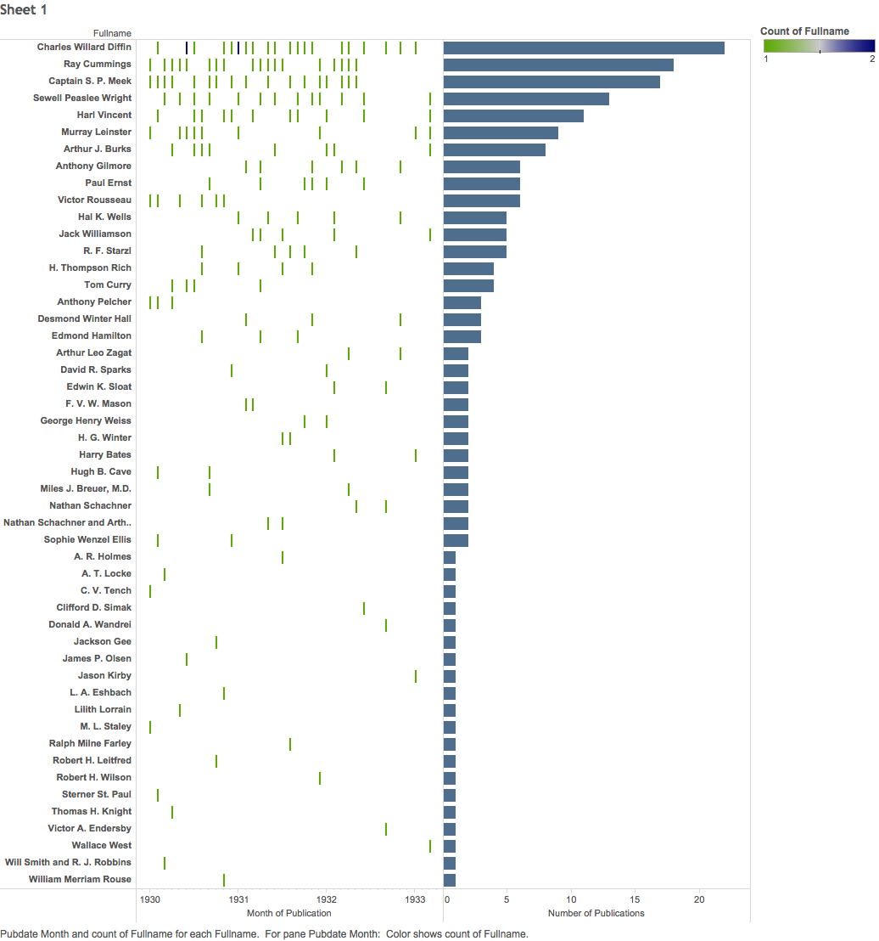

Slide 13
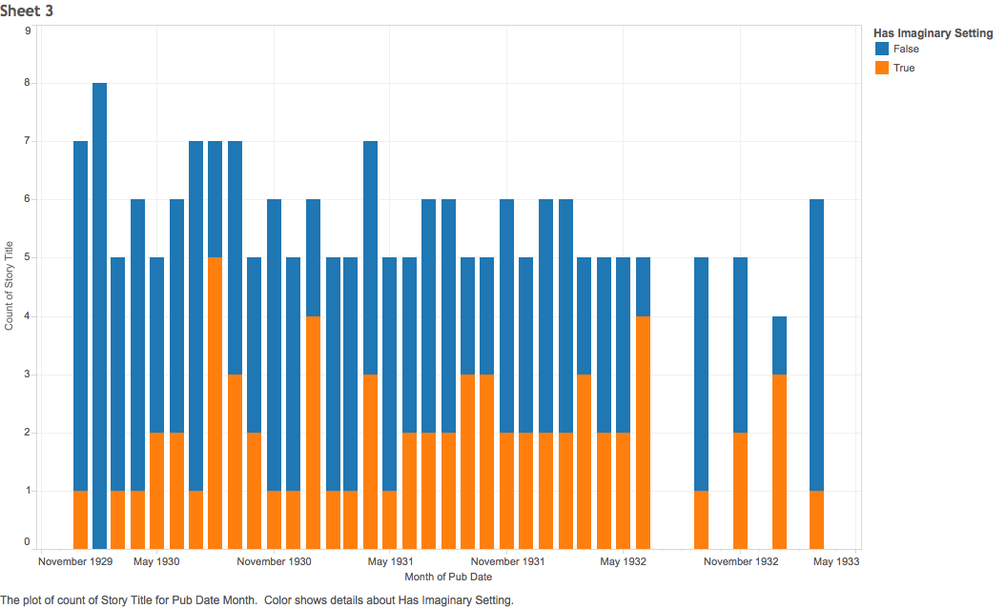

Slide 14
Publication
Write-up on fleetmeat.net
Files for individual use on fleetmeat.net
  .xlsx and .csv files of database
Files for collaboration on Google Docs
  Google Sheet of database
  Linked text files for each story
Derived visualizations on Tableau Public

